Slide 1

Advancing Health in Nepal through Technology
Welcome. We're BitBusters, a team dedicated to improving healthcare access in Nepal.

Slide 2
The Blood Donation Challenge in Nepal
The Need
Statistics
Nepal faces a critical shortage of blood donors, impacting patients in need.
Only 1% of Nepal's population donates blood regularly. This creates a significant gap in meeting the demand, particularly in emergencies and for chronic conditions.

Slide 3
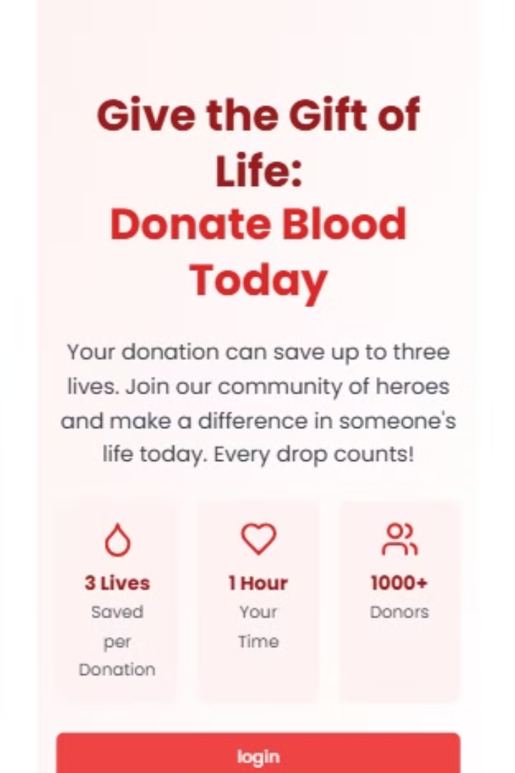
Our Solution: A Comprehensive Platform
Donor Management
Recipient Management
Streamlined registration and profile management for donors, allowing them to track donations and share information.
Facilitates blood requests, donor search, and direct communication between recipients and donors.
Real-Time Data
Interactive maps and charts visualize donor and recipient information, enabling better resource allocation and outreach.

Slide 4




Impact: Connecting Lives and Promoting a Culture of Giving
Increased Access
Our platform connects donors and recipients, ensuring a more efficient and timely blood supply.
Saving Lives
By facilitating blood donations, our platform plays a crucial role in saving lives and alleviating suffering.
Building Trust
The platform promotes a culture of regular blood donation, fostering a sense of community and responsibility.

Slide 5



A Sustainable Business Model
Data Insights
1
We monetize by selling valuable data and insights about blood donation patterns and trends.
Partnerships
2
Collaborations with blood banks and hospitals provide a platform for impactful outreach and resource management.
Corporate Support
3
Sponsorships from corporations with a commitment to social responsibility drive further impact and resource expansion.

Slide 6
Key Technical Components
Frontend
Backend
React, Tailwind CSS, and Vite provide a dynamic and user-friendly interface for donors and recipients.
Node.js, Express, and MongoDB create a robust and scalable backend for managing user data, requests, and interactions.

Slide 7

Next Steps: A Collaborative Journey
We invite you to partner with us and become part of this transformative journey.

